Slide 1
Project Cost Management
Project Management
Paul Vesey
Limerick Institute of Technology
paul.vesey@lit.ie
Autumn 2019
1 / 128

Slide 2
Project Management
Project Cost Management Introduction
Project Cost Management
Consists of 3 Processes
Estimate Cost
Determine Budget
Control Costs
Project Cost Management is primarily concerned with the cost of resources needed to complete schedule activities
Project Cost Management is not the same as Life-Cycle Costing
2 / 128

Slide 3
Project Management
Project Cost Management Introduction
Project Cost Management
Estimate Costs
Developing an approximation of the costs of the resources needed to complete project activities
Determine Budget
Aggregating the estimated costs on individual activities or work packages to establish a cost baseline
Control Costs
Influencing the factors that create cost variances and controlling changes to the project budget
3 / 128

Slide 4
Project Management
Project Cost Management Introduction
Project Cost Management
Different stakeholders will measure project costs in different ways; this can have a major effect on finance reporting
Typically these variances will be on how costs are booked to the project.
e.g. Large AHUs (over €20k) may be booked to the project when the order is placed, and a portion of the bill item may be invoiced to the client when the equipment is delivered to site.
4 / 128

Slide 5
Project Management
Project Cost Management Introduction
Project Cost Management
On small projects Estimating Costs and Determining Budget are sometimes so closely linked that determining where one finished and the other starts is virtually impossible
This would rarely (if ever) apply to construction contracts.
Estimating is carried out at tender stage; budgeting at construction stage
Typically, construction firms struggle with cash-flow due to the time between incurring costs associates with work, and actually getting paid for it.
Most construction contracts have a retention clause (circa 5%) which needs to be considered in cash flow projections and Earned Value Analysis.
5 / 128

Slide 6
Project Management
Project Cost Management Introduction
Project Cost Management
Early stages of a project have the greatest influence in the overall costs associated with a project
This is one of the main reasons why correctly scoping a project is so important.
Construction Projects can have difficulty with this aspect, especially when consideration is given to the concept of progressive elaboration; something that is inherent in construction projects
Scope Creep is another issue that needs to be watched. . .
6 / 128

Slide 7
Project Management
Project Cost Management Introduction
Cost Management Plan
Establishes the Precision Level to be used for cost estimates
Nearest €100, €1000, etc.
Defines Units of Measure
staff-hours, staff-weeks, lump sum etc.
Control Accounts
As per WBS
Control Thresholds
Limits to acceptable variations against budgeted figures
7 / 128

Slide 8
Project Management
Project Cost Management Introduction
Cost Management Plan
Performance Measurement Rules
Earned Value Management formulas
WBS level to which Earned Value analysis will be applied Etc.
Reporting Formats Process Descriptions
8 / 128

Slide 9
Project Management
Project Cost Management
Introduction
Project Cost Management Points to Consider
Cost Management is not Cost Monitoring
Just because you know how much cost has been incurred (or booked) to a project, it does not necessarily mean you are in control of the situation
Poor cash flow can kill a company.
If a project is due to run for a considerable length of time, longer than 12 months, pay particular attention to the CPA clause.
Be wary of links to the Consumer Price Index; it may not represent your actual increases in cost
Better to look for:
Table 1 Average Earnings and Hours Worked by Skilled and Unskilled Operatives for Earnings and Hours worked in Construction
Table 3 Wholesale Price Indices (excluding VAT) for
Building and Construction Materials from the Wholesale Price Index
9 / 128

Slide 10
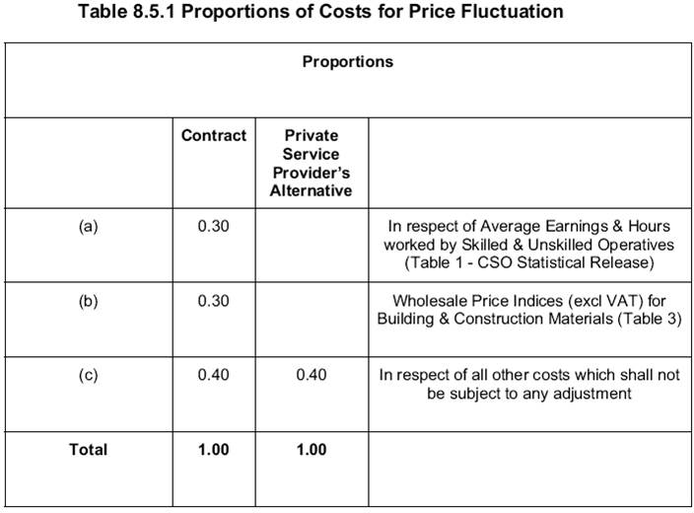
Project Management
Project Cost Management Introduction
Project Cost Management
Example CPA table
Figure: CPA Table
10 / 128

Slide 11
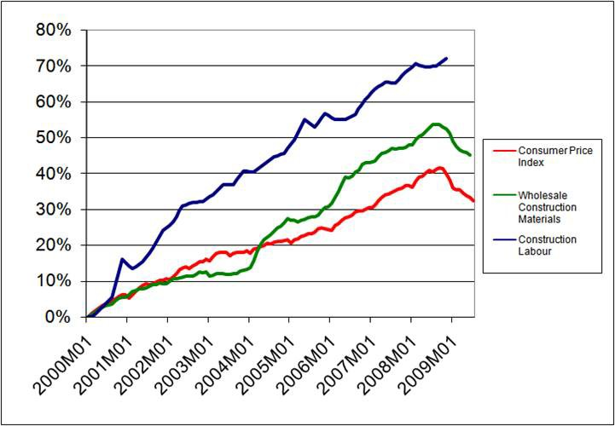
Project Management
Project Cost Management Introduction
Effects of Inflation

Slide 12
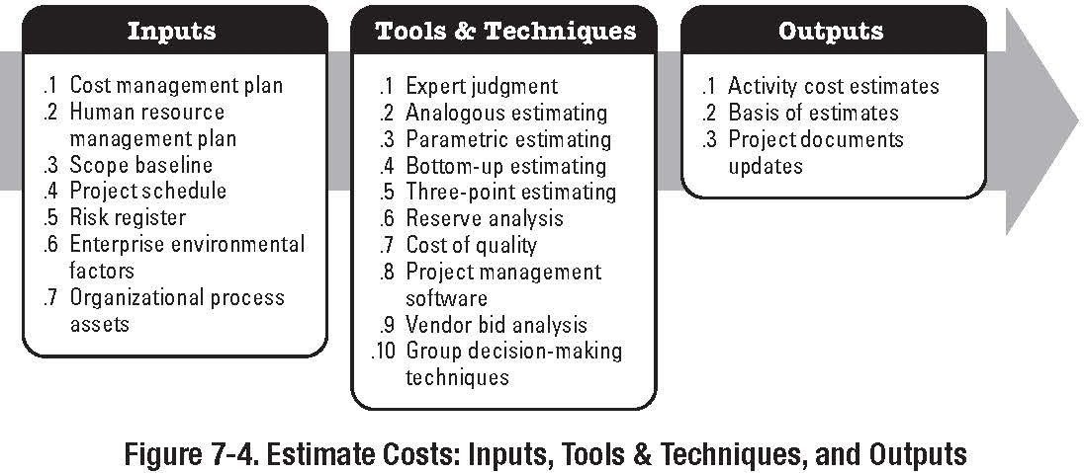
Project Management
Project Cost Management Introduction
Estimate Costs
Part of the Planning Process Group

Slide 13
Project Management
Project Cost Management Introduction
Estimate Costs
Cost Estimating is not the same as Pricing
Pricing is concerned with what you should pay
Cost estimating is concerned with what an activity will actually cost the performing organisation
Inputs
As per book
Enterprise Environmental Factors (Marketplace Conditions)
What is available, from whom, and under what terms and conditions
Published Commercial Information. May be an electronic database (CSO) or printed (SPON)
Information on skills and labour costs

Slide 14
Project Management
Project Cost Management Introduction
Inputs Organisational Process Assets
Cost Estimating Policies
Predefined approaches and rules for cost estimating Typically generated by finance department or PMO
Cost Estimating Templates
Standardised forms and methods
Can be restrictive; but lessen the likelihood of omissions For best effect, they need to be flexible
Historical Information
The performing organisations experiences may influence costing
Files from previous projects of a similar nature can be reviewed for costing techniques and validation of estimated costs
Project Team Knowledge

Slide 15
Project Management
Project Cost Management Introduction
Inputs
Organisational Process Assets
Lessons Learned
Lessons learned from previous projects of a similar nature
Project Scope Statement: Includes information that is likely to impact cost estimates
Constraints, Assumptions, Requirements, Etc.
Also contains deliverables and acceptance criteria: these must be considered when estimating cost.
Technical Issues and Concerns
again, likely to influence cost

Slide 16
Project Management
Project Cost Management Introduction
Inputs
Project Schedule
The types and quantities of resources, and the amount of time they are applied clearly makes up the most significant element of a cost estimate.
Estimate Activity Resources and Activity Duration Estimates provide key information for cost estimation
Most construction projects run for 6-months or more; financing, interest rates, Contract Price Adjustment (CPA) will have a significant effect
Consideration should also be given to time-sensitive cost estimates

Slide 17
Project Management
Project Cost Management Introduction
Tools and Techniques
Analogous Estimating
Using actual costs from a similar project to estimate costs for current project
Determine Resource Cost Rates
Staff Cost per hour
Material Bulk Cost, m³, m², etc. Quotations
SPON etc
Bottom-up Estimating
Involves estimating costs to the lowest levels of the WBS (work packages)

Slide 18
Project Management
Project Cost Management Introduction
Tools and Techniques
Parametric Estimating
Parametric Estimating involves using the relationship between historical data and other variables to generate an estimate
i.e. data: average cost of concrete over the last 12 months is €72.00 per m³
Variable: estimate requires 1000m³ of concrete Cost Estimate for Concrete €72,000
Should also include an “x-factor” to cover inflation, profit,
etc.

Slide 19
Project Management
Project Cost Management Introduction
Tools and Techniques
Vendor Bid Analysis
Solicitation of quotations for various project elements from a number of sources.
These are then analysed to assist in determining cost
Note: It is not always a good idea to use the lowest figures obtained. Better to analyse properly and determine an average or consensus figure at tender stage. (Why?)

Slide 20
Project Management
Project Cost Management Introduction
Tools and Techniques
Reserve Analysis
AKA Contingency Sums : for use on known-unknowns identified in the scope or during risk management
Can inflate project prices; impacts competitiveness
Project Management Estimating Software
Cost Estimating elements of PM software
Can also be spreadsheets, specialist estimating software, Buildsoft, etc.

Slide 21
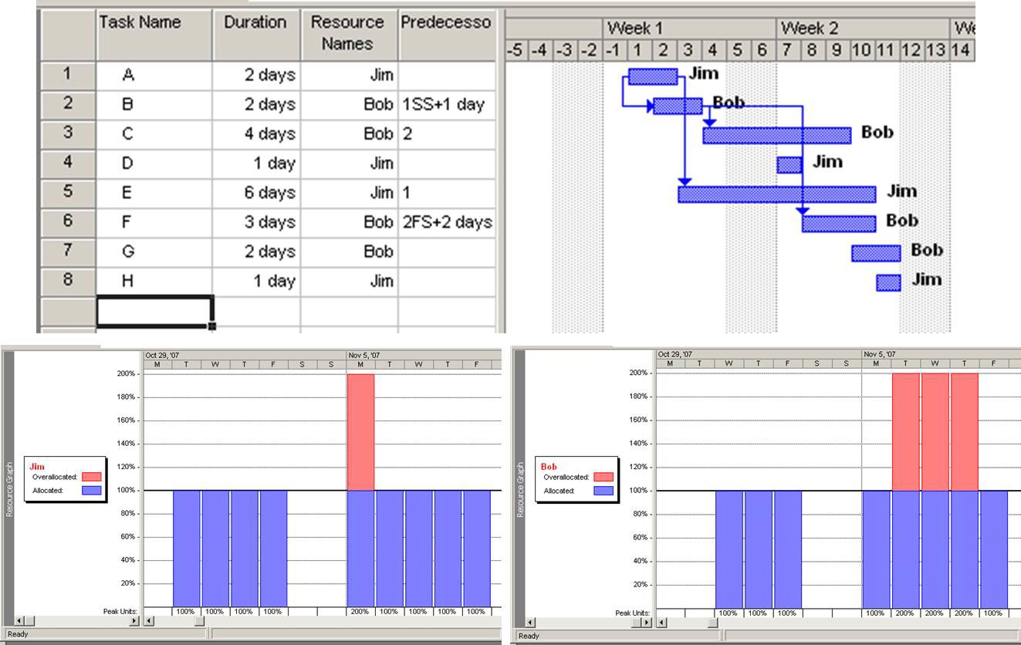
Project Management
Project Cost Management Introduction
Project Management Software
MS Project Example

Slide 22
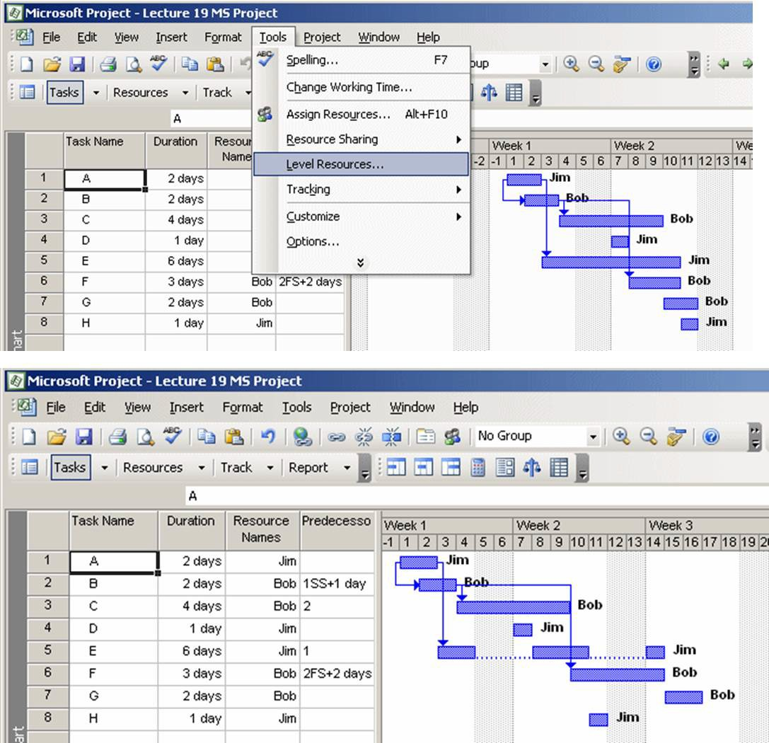
Project Management
Project Cost Management Introduction
Resource Leveling
Resource Graph (View — Resource Graph)

Slide 23
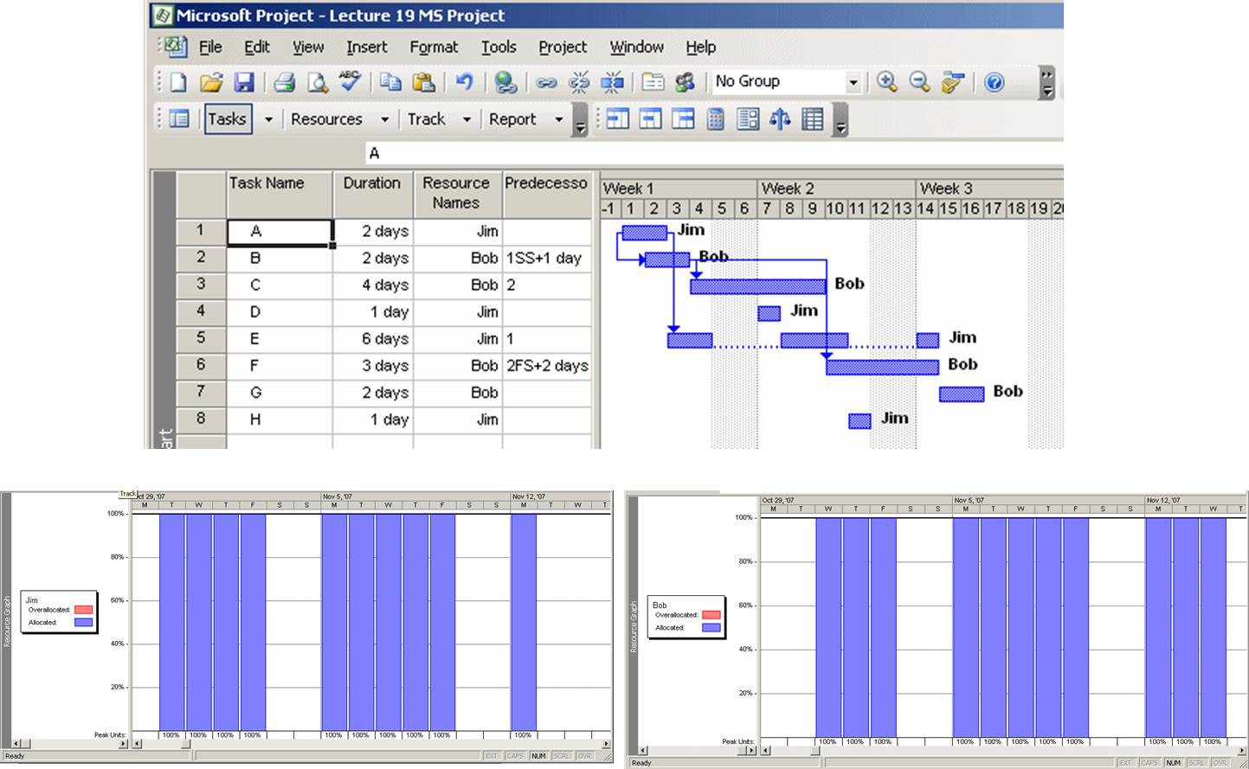
Project Management
Project Cost Management Introduction
Resource Leveled

Slide 24
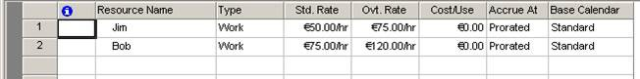
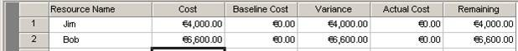
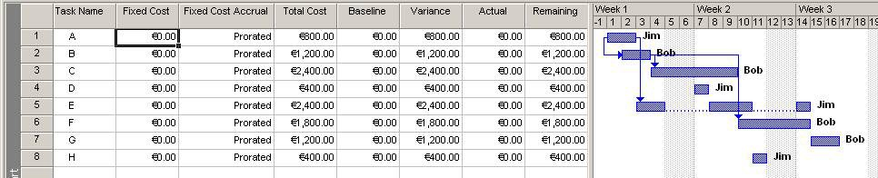
Project Management
Project Cost Management Introduction
MS Project
View — Resource Sheet
View — Table : Cost
View — Gantt Chart then— View — Table : Cost

Slide 25
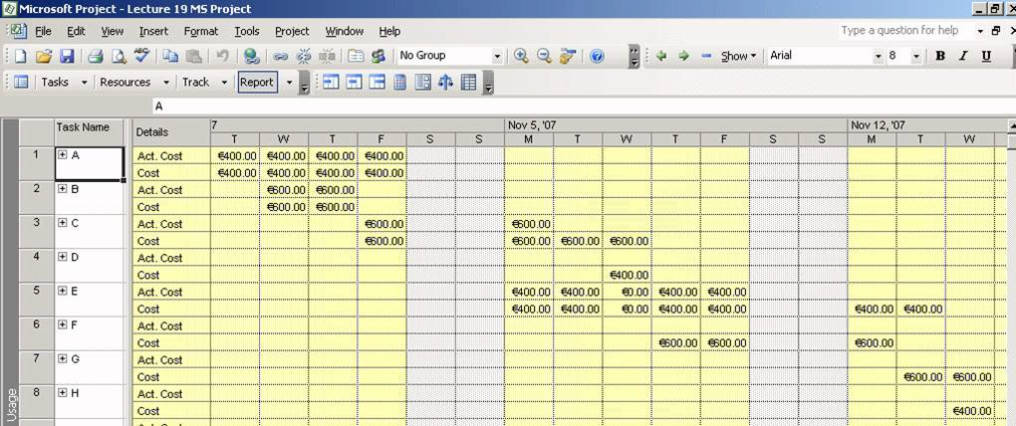
Project Management
Project Cost Management Introduction
MS Project
View — Task Usage

Slide 26
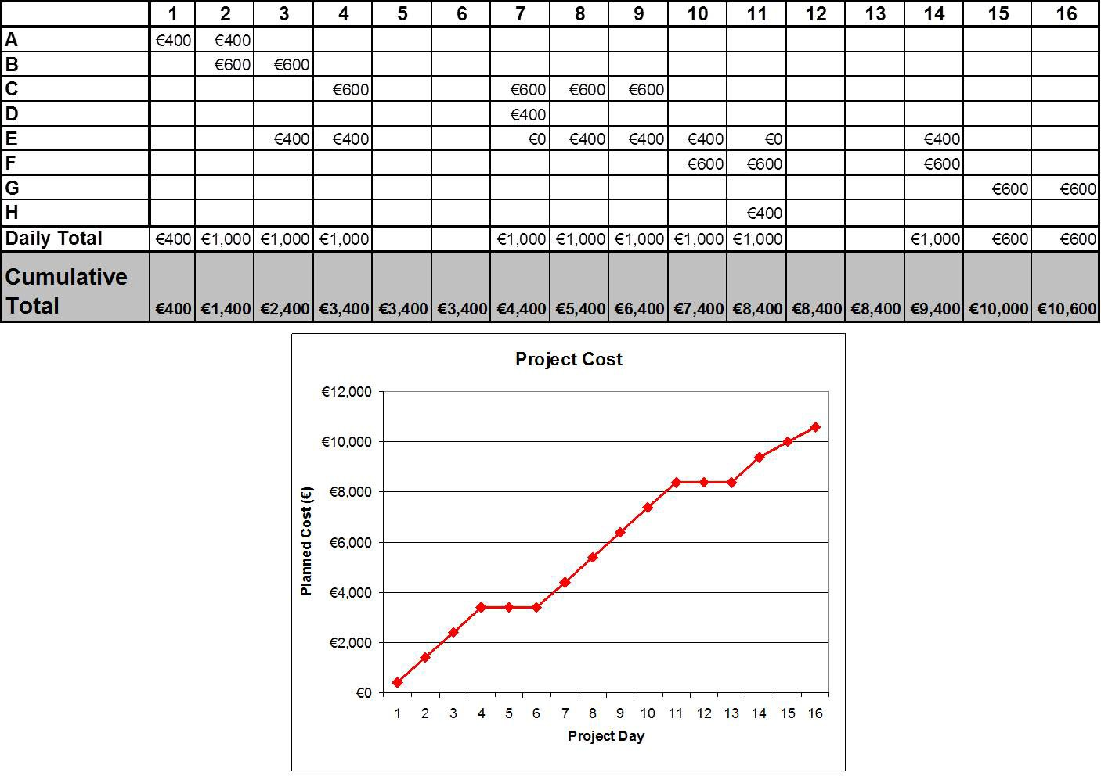
Project Management
Project Cost Management Introduction
Imported to Excel

Slide 27
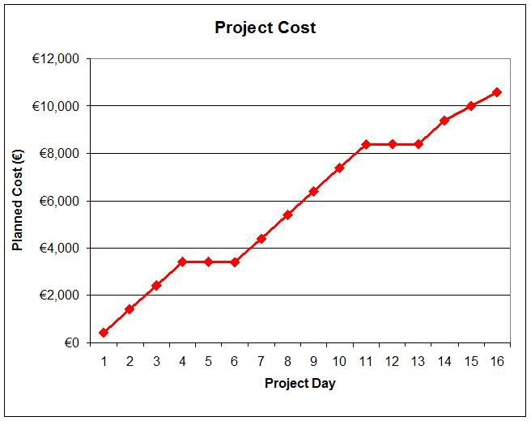
Project Management
Project Cost Management Introduction

Slide 28
Project Management
Project Cost Management Introduction
Tracked Costs

Slide 29
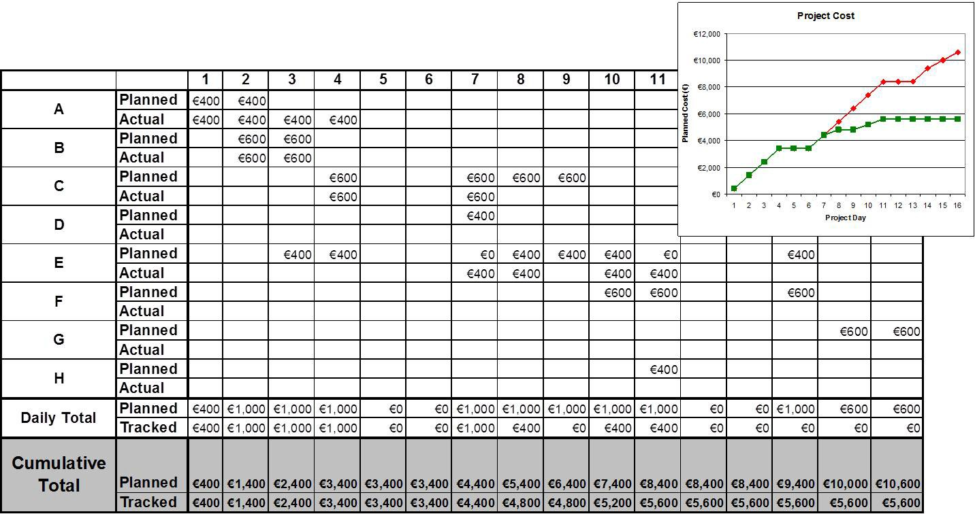
Project Management
Project Cost Management Introduction
Imported to Excel

Slide 30
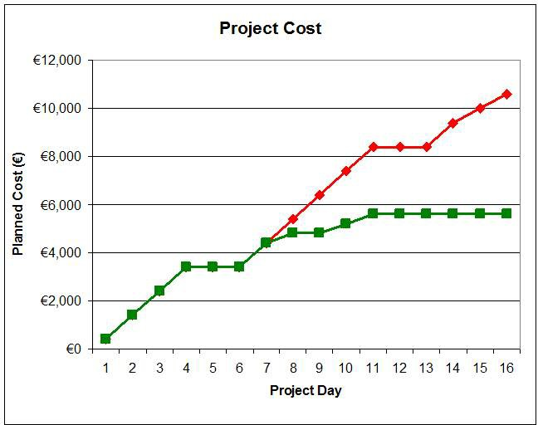
Project Management
Project Cost Management Introduction

Slide 31
Project Management
Project Cost Management Introduction
Cost Estimating Outputs
Activity Cost Estimates: Quantitative Estimates of the likely costs of the resources required to complete schedule activities
Labour, Materials, Equipment, Services, Facilities, IT, etc. May also include Inflation, CPA, contingency, etc.
Basis of Estimates: Provide a clear breakdown of how estimates were calculated
Description of schedule activities scope of work Documentation of basis of estimate Documentation of assumptions, constraints, etc.
Indication of range and accuracy of estimates
€25,000 ± €2,000 €12,000 to €14000 €32,000 ± 10%
€32,000 @ 90% confidence

Slide 32
Project Management
Project Cost Management Introduction
Cost Estimating
Outputs
Project Document Updates
The process of estimating may highlight specific issues that may not previously been considered.
These new issues may have to be incorporated into the Project Documentation

Slide 33
Project Management
Project Cost Management Introduction
Estimating Pitfalls
Misinterpretation of Statement of Work Omissions or Improperly defined Project Scope Poorly defined or over optimistic project schedule Inaccurate Work Breakdown Structure (WBS) Applying improper skill level to tasks
Failure to account for Risk
Failure to account for CPA and Inflation
Failure to use forward pricing rates for overhead, general admin, etc.
Most of these pitfalls are tend not to be recognised until the project is well underway.

Slide 34
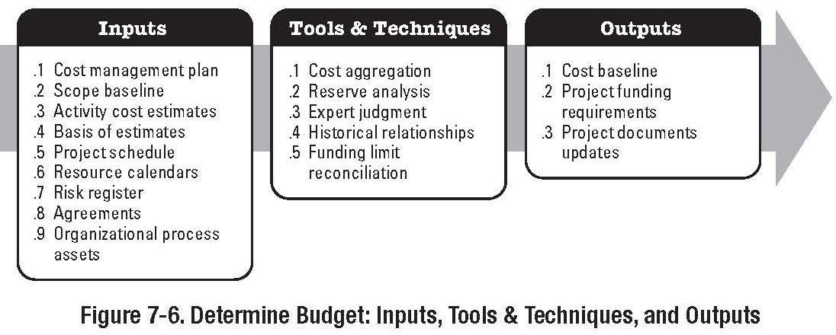
Project Management
Project Cost Management Cost Budgeting
Cost Budgeting
Part of the Planning Process Group

Slide 35
Project Management
Project Cost Management Cost Budgeting
Cost Budgeting
Golden Rule of Budgeting:
If you have the data; USE IT
Most Project Management Systems, Accounts Systems, and other software systems will hold data that can be used for budgeting and subsequent cost control processes.
Quantitative Data analysis is not that difficult to perform once you have setup a system that works.

Slide 36
Project Management
Project Cost Management Cost Budgeting
Sigmoid curve
Mathematical formula for S-curves:
f (x) = ¹
1 + e^{−t}
f (x) = ¹
λ + βe^{−αt}

Slide 37
Project Management
Project Cost Management Cost Budgeting
Sigmoid curve
Mathematical formula for S-curves:
% Budget
100%
f (x) =
1
1+e
−t
75%
50%
25%
Project Time
Project Time

Slide 38
Project Management
Project Cost Management Cost Budgeting
Effect of changing α
% Budget
α = 6.00 α = 2.00
f (x) =
1
100%
1+e
−t
α = 0.50
α = 0.25
75%
50%
25%
Project Time
Effect of Changing α
α controls the slope of the curve

Slide 39
Project Management
Project Cost Management Cost Budgeting
Effect of Changing β
% Budget
β = 0.05
β = 0.25
100%
β = 5.00
β = 15.00
75%
50%
25%
Project Time
Effect of Changing β
β controls when the curve will start to increase

Slide 40
Project Management
Project Cost Management Cost Budgeting
Effect of Changing λ
% Budget
150%
λ = 0.75
125%
100%
f (x) =
1
1+e
−t
75%
λ = 1.50
λ = 2.00
λ = 3.00
50%
25%
Project Time
Effect of Changing λ
λ controls the end point; use this to correct to 100% when α
and β distort the end point.

Slide 41
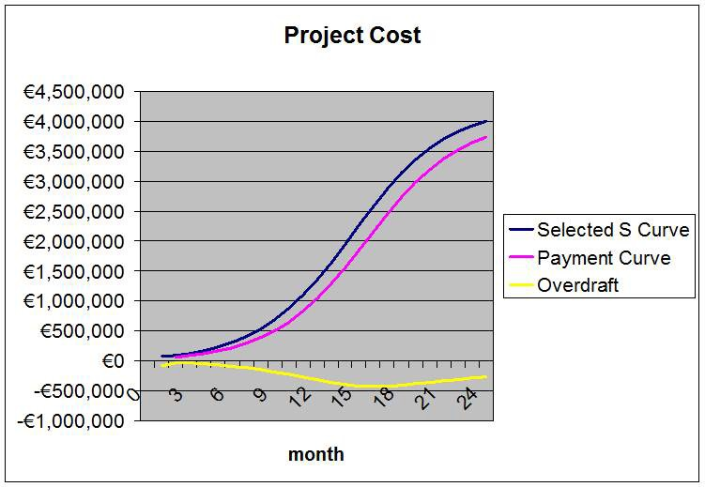
Project Management
Project Cost Management Cost Budgeting
Consider a € 4,000,000 contract (ex VAT) that is to be executed over 24 months.
By examination of the cost estimates, the S-curve for project costs has been determined to have an α of 0.6, a β of 2.0 and a λ=0.945
Assumptions
Interim Payment Certification and Payment of Invoice takes 1 month
Retention of 5% for 12 months
Results
Based on this model the project will be overdrawn.
Peak overdraft is € 423k in month 16
Total cost of overdraft is over € 34,500 at 7% p.a. at month 24
By month 36 the cost of overdraft is over € 53k

Slide 42
Project Management
Project Cost Management Cost Budgeting
Results

Slide 43
Project Management
Project Cost Management Cost Budgeting
Results
If the project is on a 10% margin (€ 400k), the cost of the overdraft will reduce the margin to approximately 8.67%
This calculation assumes that all works claimed for are certified. If there is delay in certification then the cost of overdraft will be increased, and margins reduced further

Slide 44
Project Management
Project Cost Management Cost Budgeting
Effects of Inflation

Slide 45
Project Management
Project Cost Management Cost Budgeting
Effects of Inflation
A tender was submitted at a value of € 5,000,000 in Jan 2004.
The tender was submitted at 15% margin The project is expected to run for 24 months.
The validity of the tender was 180 days, which was extended by 90 days.
The CPA clause in the contract was based on the Consumer Price Index (CPI).

Slide 46
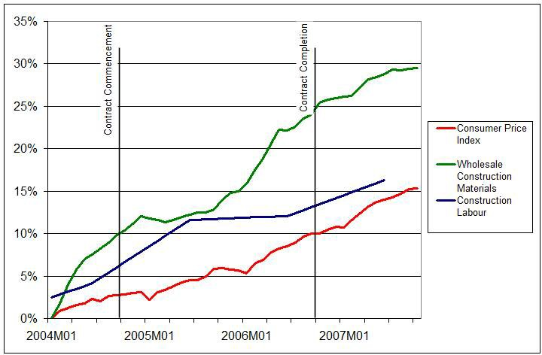
Project Management
Project Cost Management Cost Budgeting
Inflation Data for Contract Period

Slide 47
Project Management
Project Cost Management Cost Budgeting
Assumptions and known information
Margin on the contract is € 750,000 Costs are € 4,250,000
Indirect Costs are assumed to be included in labour.
There is an equal split between labour and materials; 50% materials, 50% labour
Material Cost = €2,125,000 Labour Cost = €2,125,000

Slide 48
Project Management
Project Cost Management Cost Budgeting
At time of Contract Start
CPI = 2.723%
Labour Index = 6.044 Material Index = 9.80
Cost Increase to Contractor
€2,125,000 × 1.06044 = €2,253,435.00 €2,125,000 × 1.0980 = €2,333,250.00 Total €4,586,685.00
Recoverable via CPA based on CPI
€5,000,000 × 1.02723 = €5,136,150
Loss to Contractor
€336,685 - €136,150 = €200,535

Slide 49
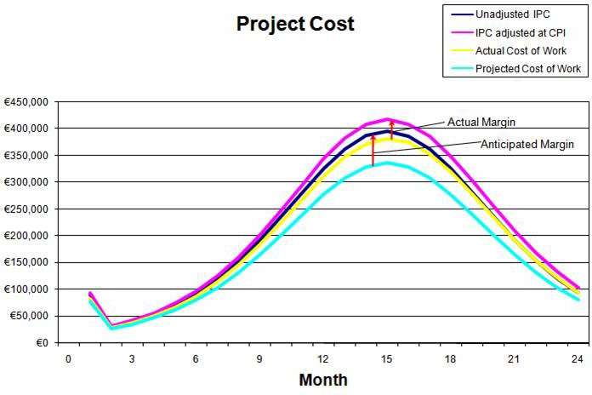
Project Management
Project Cost Management Cost Budgeting

Slide 50
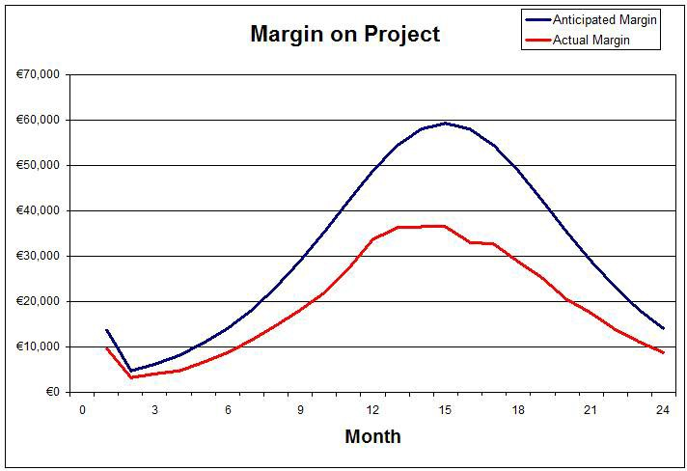
Project Management
Project Cost Management Cost Budgeting

Slide 51
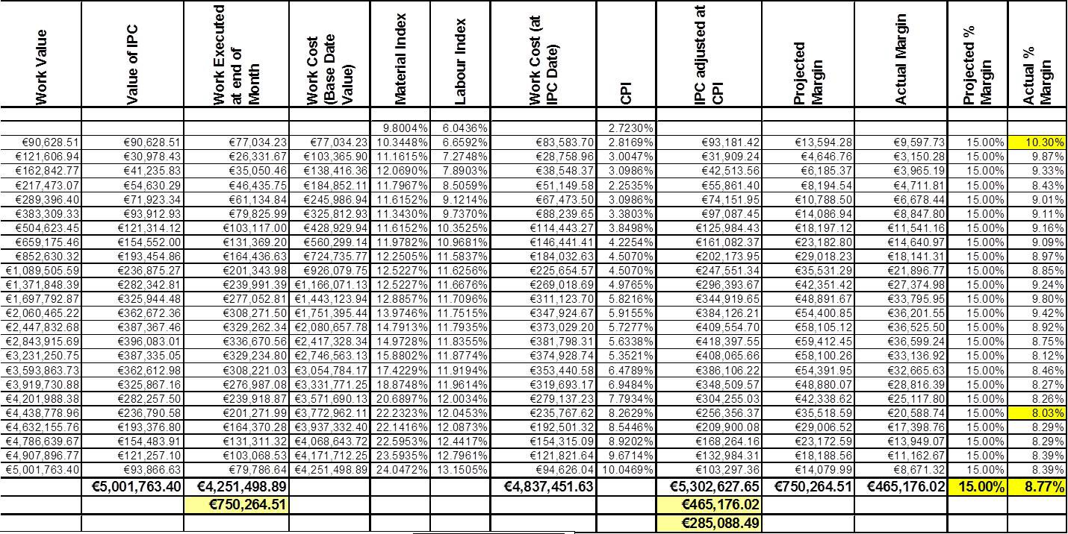
Project Management
Project Cost Management Cost Budgeting
Excel Table on Moodle

Slide 52
Project Management
Project Cost Management Cost Budgeting
Results
Results of Analysis
Margin Reduced from 15% to 8.77%
Margin per month ranged from 10.3% to 8.03%
Value of Margin Reduced by approximately €285,000 from
€750,000 to €465,176
Margin is reduced the longer the contract continues
Failure to perform, or EOTs, likely to have a further negative impact on margin
Analysis does not include cost of cash-flow

Slide 53
Project Management
Project Cost Management Cost Budgeting
Cost Budgeting
Part of the Planning Process Group

Slide 54
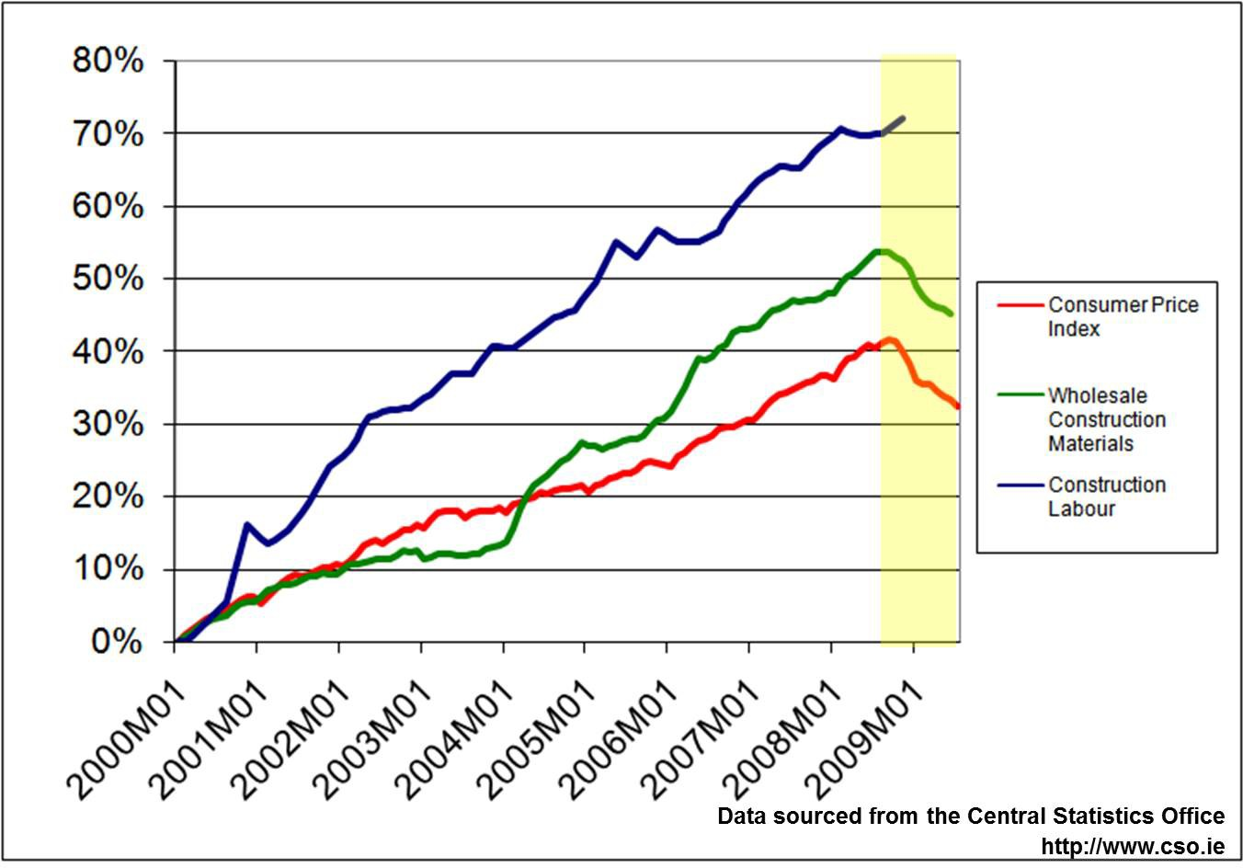
Project Management
Project Cost Management Deflation
Effects of Deflation

Slide 55
Project Management
Project Cost Management Deflation
Effects of Deflation
Difficult to predict current impact; economy appears to be on climb out.
Tenders submitted at the peak (Sep 2008) may have been revised downwards during construction phase as part of the CPA clause
If the CPI falls faster than costs, contractors margins will be under threat

Slide 56
Project Management
Project Cost Management Deflation
Effects of Deflation
Delays in Interim Payment Certification, combined with retention (5% to 10%) leads to significant financial losses. Elapsed time between actually carrying out work and getting payment certification remains critical.
In contractors interest to minimise time difference In clients interest to delay

Slide 57
Project Management
Project Cost Management Deflation
Very Simple Example
Work carried out during Sept 2008 for €1000.00 including profit Consumer Price Index: 128
Payment approved Dec 2008 Consumer Price Index: 125 Adjustment (125-128) 128 = -2.3% Payment due to contractor €977.00
Many contractors operate at circa 5% margin this margin has effectively been halved.

Slide 58
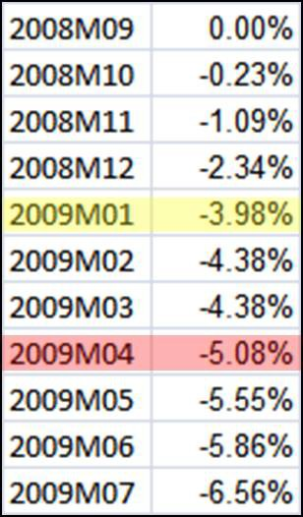
Project Management
Project Cost Management Deflation
Very Simple Example
The longer the delay the greater the profit erosion.
By January 2009 margin is 1.02%; by April the work is generating a loss.

Slide 59
Project Management
Project Cost Management Determine Budget
Determine Budget
Part of the Planning Process Group

Slide 60
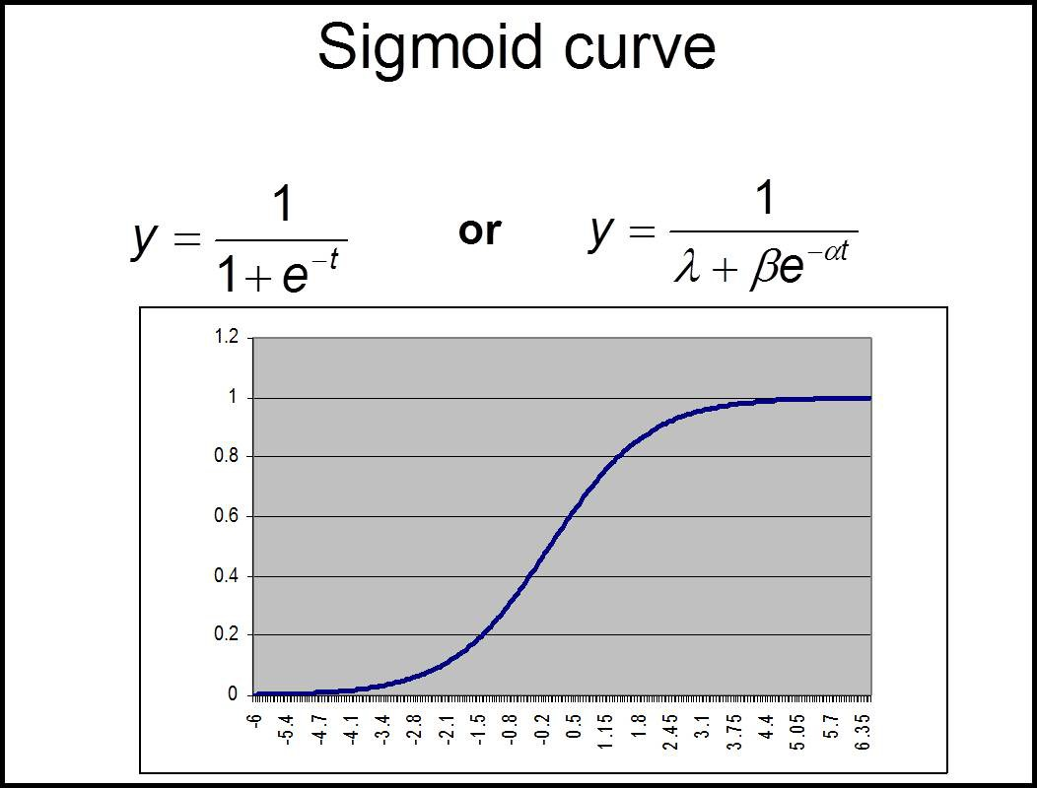
Project Management
Project Cost Management Determine Budget
Remember from Previous Lecture

Slide 61
Project Management
Project Cost Management Determine Budget
Some notes on S-Curve
S-curves are useful in at the beginning of a project
As time progresses, estimates can be refined, and a more realistic financial model can be developed
Over-reliance on S-curves can create cash-flow difficulties What if the α, β, or λ are not a good fit to the actual cash flow of the project?

Slide 62
Project Management
Project Cost Management Determine Budget
Determine Budget
Inputs
As per book
Tools and Techniques
Cost Aggregation
Sum of the costs associated with individual work packages and elements from the WBS
Reserve Analysis
Sum of project cost reserves, such as risk reserve and others
Historical Relationships
Parametric and/or analogous estimates Mathematical Models to predict total cost Refer to book
CAUTION: models should be treated with care; before use they should be fully understood

Slide 63
Project Management
Project Cost Management Determine Budget
Determine Budget Tools and Techniques
Funding Limit Reconciliation
Modification of the project program in order to smooth out the funding requirements of the project.
Needs to be treated with extreme caution by the contractor Generally beneficial to the client.
Projects generally have a value to the client, and generate a return on investment. The shorter the time between paying the contractor and realising a return from the investment, the better it is for the client
Also, loan interest is incurred from drawdown. If drawdown can be postponed, less loan interest is incurred.
Both parties need to be aware of Contract Price Adjustment (CPA) Clause and effects

Slide 64
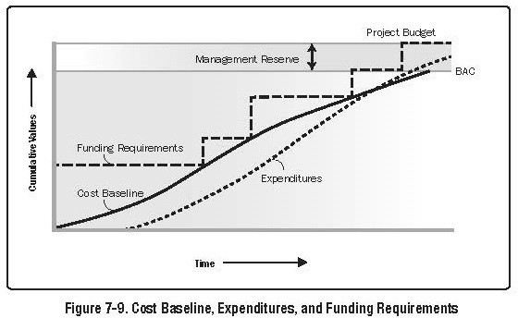
Project Management
Project Cost Management Determine Budget
Determine Budget

Slide 65
Project Management
Project Cost Management Determine Budget
Determine Budget
Outputs
Cost Performance Baseline
Time based budget that is used as a basis against which to measure, monitor, and control overall cost performance on the project.
Can be shown as an S-curve
For large construction projects it is normal to include far more detail and track costs against specific cost codes and cost centres.

Slide 66
Project Management
Project Cost Management Determine Budget
Determine Budget
Outputs
Project Funding Requirements
Details the total and periodic funding requirements
Also included a margin for error or changes that may be required
Generally funding requirement are represented by a step function, See Fig 7-9
Contingency reserves are normally spread evenly over the duration of the project.

Slide 67
Project Management
Project Cost Management Determine Budget
Determine Budget
Outputs
Project Document Updates
Cost Estimates Risk Register Project Schedule

Slide 68
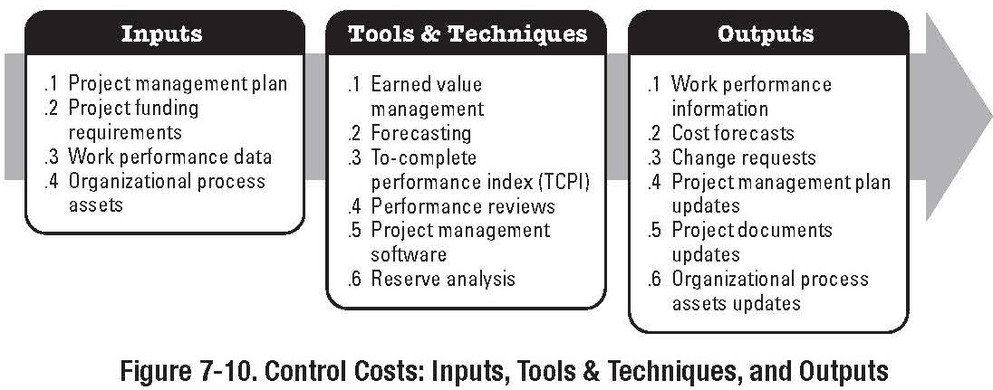
Project Management
Project Cost Management Determine Budget
Control Costs
Part of the Monitoring & Controlling Process Group

Slide 69
Project Management
Project Cost Management Determine Budget
Control Costs
Influencing the factors that create changes to the cost baseline
Ensuring requested changes are agreed upon Managing the actual changes when and as they occur
Assuring that potential cost overruns do not exceed the authorised funding for the project (total and periodic)
Monitoring cost performance to detect and understand variances from the cost baseline

Slide 70
Project Management
Project Cost Management Determine Budget
Control Costs
Recording all appropriate changes accurately against the cost baseline
Preventing incorrect, inappropriate, or unapproved changes from being included in the reported cost or resource usage
Informing appropriate stakeholders of approved changes
Acting to bring expected cost overruns within acceptable limits (Variations)

Slide 71
Project Management
Project Cost Management Determine Budget
Control Costs Inputs
Cost Baseline and Management Plan
Already covered
Project Funding Requirements
Already covered
Performance Reports
Information and reports on actual cost and resource performance
Work Performance Information
Deliverables completed and not yet completed Costs authorised and incurred
Estimates to complete schedule activities
%age completion of schedule activities

Slide 72
Project Management
Project Cost Management Determine Budget
Control Costs Inputs
Organisational Process Assets
Cost Control policies, procedures & guidelines Cost Control Tools
Monitoring and Reporting Methods
Tools and Techniques
Earned Value Management Forecasting
To-Complete Performance Index (TCPI) Performance Reviews
Variance Analysis PM Software

Slide 73
Project Management
Project Cost Management Determine Budget
Control Costs Key Terms
Planned Value (PV) Earned Value (EV) Actual Cost (AC)
Estimate to Completion (ETC) Estimate at Completion (EAC) Cost Variance (CV)
Schedule Variance (SV)
Cost Performance Index (CPI) Schedule Performance Index (SPI)

Slide 74
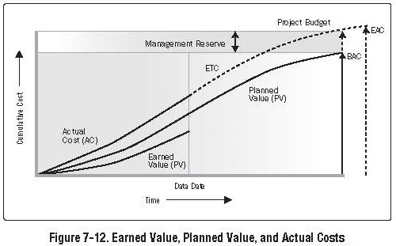
Project Management
Project Cost Management Determine Budget

Slide 75
Project Management
Project Cost Management Determine Budget
Control Costs- Performance Measurement Analysis
Cost Variance
CV = Earned Value − Actual Cost CV = EV − AC
Schedule Variance
SV = Earned Value − Planned Value SV = EV − PV

Slide 76
Project Management
Project Cost Management Determine Budget
Control Costs- Performance Measurement Analysis
Cost Performance Index
Do not confuse with consumer price index..
CPI = ^{EV}
AC
CPI less than 1.0 indicates cost overrun
CPI greater than 1.0 indicates cost underrun
Schedule Performance Index
_{SPI =} Earned Value
Planned Value
SPI = ^{EV}
PV

Slide 77
Project Management
Project Cost Management Earned Value Management
Earned Value Management System
Earned Value is a management technique that relates resource planning to schedules and technical performance requirements
Earned Value Management (EVM) is a systematic process that uses earned value as the primary tool for integrating cost, schedule, technical performance management and risk management

Slide 78
Project Management
Project Cost Management Earned Value Management
For most projects, determination of project progress is extremely difficult without an Earned Value Measurement System (EVMS)
Consider a 12 month project:
value €2.5M 10 deliverables
Report at month 6: cost €1.75M;
4 deliverables complete; 3 deliverables started.
Is the project 50%, 70% or 40% complete?

Slide 79
Project Management
Project Cost Management Earned Value Management
By integrating cost, schedule, technical performance management and risk management, an EVMS will:
Accurately show project status
Assist in the early detection of problems Assist in the early detection of cost trends
Assist in determining the success of corrective actions
EVMS emphasises prevention over cure by identifying and resolving potential issues early.

Slide 80
Project Management
Project Cost Management Earned Value Management
Variance
Cost Variance
CV = Earned Value − Actual Cost
Compares deviation from budget
Does not provide a measure of work scheduled against work completed
Schedule Variance
SV = Earned Value − Planned Value
Provides a comparison between planned and actual performance, but does not include costs.

Slide 81
Project Management
Project Cost Management Earned Value Management
Example
A project was expected to incur costs of €100k each week for 4 weeks (PV)
Actual expenditure by the end of week 4 was €325k (AC), and the Earned Value (EV) was measured at €300k.
What is the project status?
Cost Variance = 300k - 325k = -25k (cost overrun) Schedule Variance = 300k 400k = -100k (behind schedule) CPI = 300/325 = 0.92 (less than 1.0 therefore cost overrun)
SPI = 300/400 = 0.75 (less than 1.0 therefore behind schedule)

Slide 82
Project Management
Project Cost Management Earned Value Management
CV,SV, CPI and SPI Trends
Taken in isolation, CV, SV, CPI and SPI have relatively little value; however when graphed over the course of a project trends will emerge that will indicate the project status in a more meaningful way

Slide 83
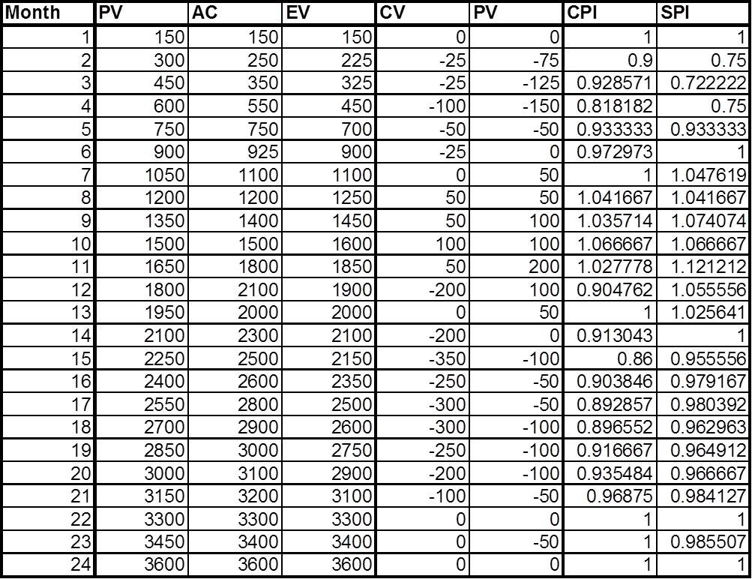
Project Management
Project Cost Management Earned Value Management
CV,SV, CPI and SPI Trends
Consider the following example:

Slide 84
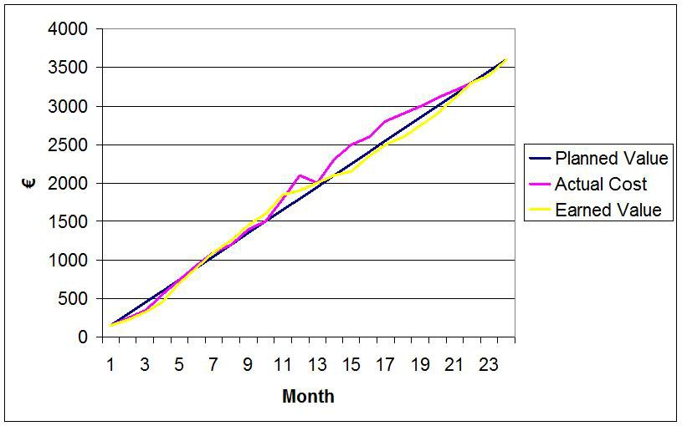
Project Management
Project Cost Management Earned Value Management
PV, AC, and EV Trends

Slide 85
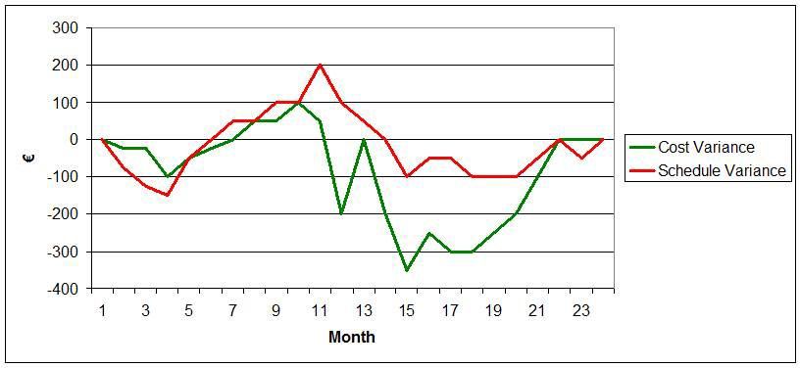
Project Management
Project Cost Management Earned Value Management
CV and SV Trends

Slide 86
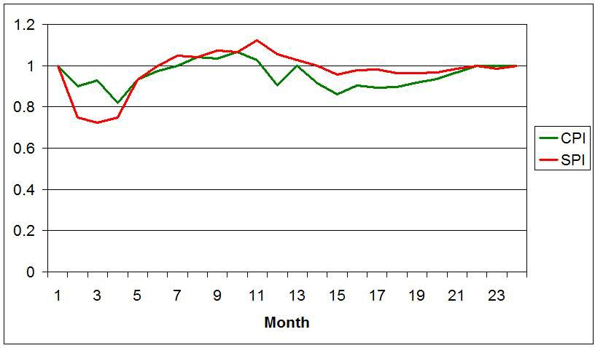
Project Management
Project Cost Management Earned Value Management
CPI and SPI Trends
Favourable or unfavourable trends are very easily identified when the data is graphed.

Slide 87
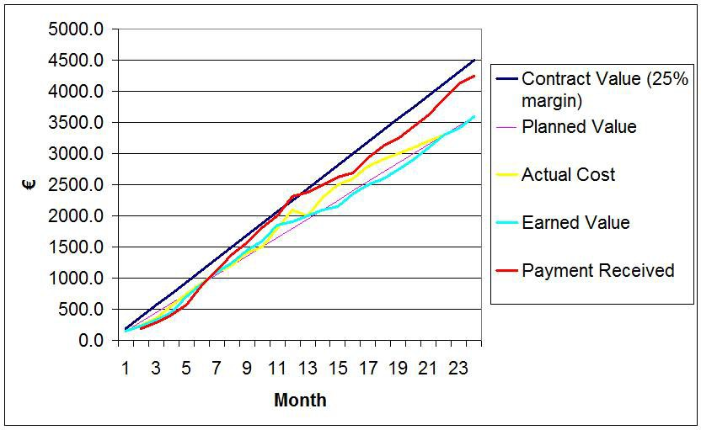
Project Management
Project Cost Management Earned Value Management
Additional data can also be easily added:
In this case Contract Value and Payments Received have been included on a PV,AC and EV graph

Slide 88
Project Management
Project Cost Management Earned Value Management
Variance Analysis
When analysing variance, a number of key questions need to be considered
What is the problem causing the variance?
What is the impact on time, cost and performance? What is the impact on other efforts, if any?
What corrective action is planned or underway?
What are the expected results of the corrective action?

Slide 89
Project Management
Project Cost Management Earned Value Management
Work in Progress : 50-50 Rule
One of the drawbacks of EVM systems is determining the earned value (EV) of Work in Progress (WIP) where estimating resource input is impractical. Often the 50-50 rule is used to estimate the earned value of WIP in these cases
Example:
Work package cost, €15,000 Work package duration, 2 weeks Cost at end of week 1 is €10,000
Therefore %age completion of the task using the 50-50 rule is:
0.5(1/2) + 0.5(10,000/15,000)
0.25 + 0.333 = .583 or 58.3
Therefore EV of work package is €8,745

Slide 90
Project Management
Project Cost Management Earned Value Management
Estimate to Completion (ETC)
The baseline budget for a project is often referred to in EVM as the Budget at Completion, or BAC. (see fig. 7-7)
In general projects rarely follow the baseline budget
Therefore, it is necessary to estimate the remaining cost to complete the project at various intervals as the project progresses
As the project progresses the accuracy of the ETC will be improved.
Revisions of the ETC are carried out at appropriate intervals, such as weekly or monthly.

Slide 91
Project Management
Project Cost Management Earned Value Management
Estimate to Completion (ETC)
ETC can be calculated in a number of ways
ETC using a new estimate
ETC using the remaining budget ETC using CPI
ETC using new estimate
Normally only used when the original estimate is fundamentally flawed

Slide 92
Project Management
Project Cost Management Earned Value Management
Estimate to Completion (ETC)
ETC using the remaining budget
Used when variances are seen as atypical, and the project team is confident that further variances are unlikely
ETC_{BGT} = BAC − EV
ETC using CPI
Used when variances to date are seen as being indicative of future variances
_{ETCCPI =} (BAC − EV )
CPI

Slide 93
Project Management
Project Cost Management Earned Value Management
Estimate at Completion (EAC)
Another common measure used is the Estimate at Completion, EAC
In general the EAC is:
EAC = AC + ETC
As the project progresses the accuracy of the EAC will be improved.
Revisions of the EAC are carried out at appropriate intervals, such as weekly or monthly.

Slide 94
Project Management
Project Cost Management Earned Value Management
Estimate at Completion (EAC)
Like ETC, EAC can be calculated in a number of ways
EAC using a new estimate
EAC using the remaining budget EAC using CPI
EAC using new estimate
Normally only used when the original estimate is fundamentally flawed
EAC = AC + ETC

Slide 95
Project Management
Project Cost Management Earned Value Management
Estimate at Completion (EAC)
EAC using the remaining budget
Used when variances are seen as atypical, and the project team is confident that further variances are unlikely
EAC_{BGT} = AC + BAC − EV
EAC using CPI
Used when variances to date are seen as being indicative of future variances
_{EACCPI = AC +} (BAC − EV )
CPI

Slide 96
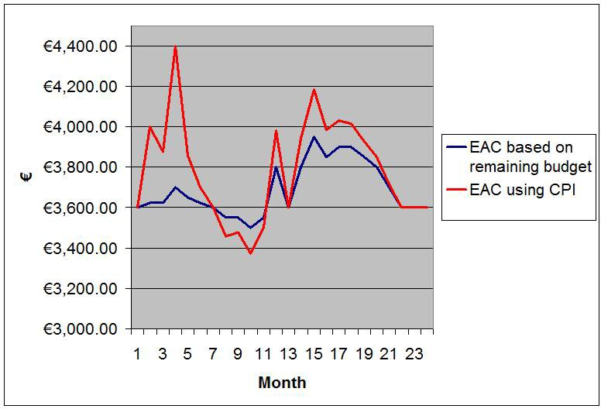
Project Management
Project Cost Management Earned Value Management
Comparison of EAC results

Slide 97
Project Management
Project Cost Management Earned Value Management
Cost Control Problems
Poor estimating techniques and/or Standards, resulting in unrealistic budgets
Out of sequence start and completion of activities Inadequate WBS
Lack of Management policy on reporting and control practices
Reducing budgets or bids to be competitive or eliminate fat Unnoticed or uncontrolled scope change
Poor comparison of actual and planned costs Unforeseen technical problems
Schedule delays that require overtime or idle time Unrealistic CPA clause

Slide 98
Project Management
Project Cost Management Earned Value Management
Causes of Cost Overrun
Proposal Phase
Failure to understand requirements Unrealistic appraisal of in-house capability Underestimation of time requirements
Planning Phase Omissions Inaccurate WBS
Misinterpretation of information
Wrong or inaccurate estimating techniques
Failure to identify and concentrate on major cost elements Failure to assess and provide for Risk

Slide 99
Project Management
Project Cost Management Earned Value Management
Causes of Cost Overrun
Negotiation Phase
Forcing a speedy compromise Procurement ceiling costs Must win the job attitude
Contractual Phase
Contractual discrepancies
SOW different from RFP requirements Proposal team different from project team
Design Phase
Accepting customer requests without management approval
Problems in customer communications channels and data items
Problems in Design Review meetings
99 / 128

Slide 100
Project Management
Project Cost Management Earned Value Management
Causes of Cost Overrun
Build Phase
Excessive material cost Specification that are not acceptable
Disagreement between engineering team, design team, and construction team
100 / 128

Slide 101
Project Management
Project Cost Management Earned Value Management
Cost Control Process Outputs
Cost Estimate (Updates) Cost Baseline (Updates) Performance Measurements
CV, SV, CPI, SPI
Forecasted Completion
ETC, EAC
Requested Changes Recommended Corrective Actions
Organizational Process Assets (Updates) Project Management Plan (Updates)
101 / 128

Slide 102
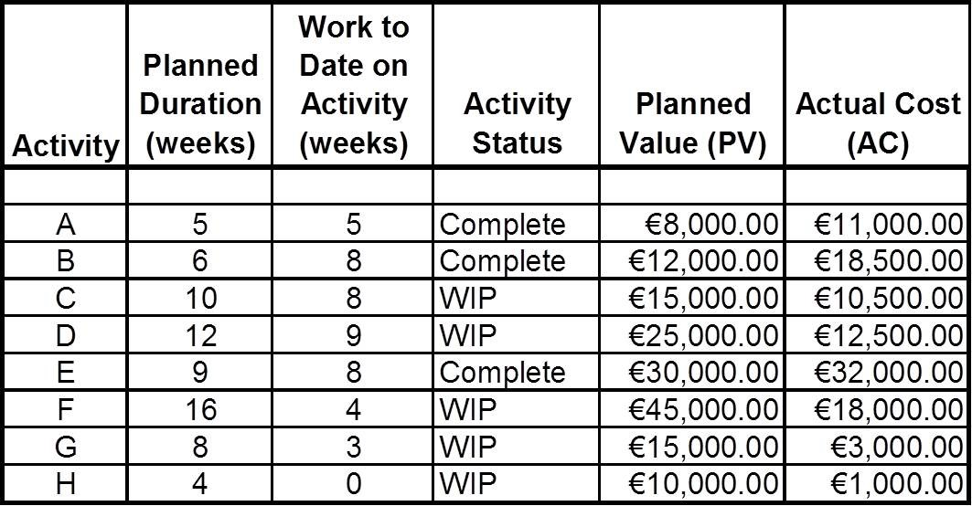
Project Management
Project Cost Management EVMS Worked Example
EVMS Worked Example
The above project has a total planned duration of 35 weeks. The project is currently at the end of week 12. Calculate:
a) | PV at week 12 | b) | EV | c) | CV
d) | CPI | e) | SV | f) | SPI
g) | ETC based on budget | h) | ETC based on CPI | i) | EAC -budget
j) | ETC based on CPI | k) | %age Completion | l) | % Budget Spent
m) | New Project Duration based on SPI
102 / 128

Slide 103
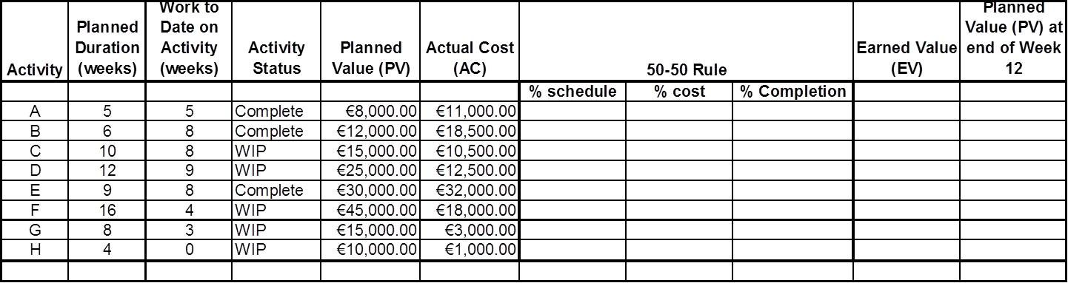
Project Management
Project Cost Management EVMS Worked Example
Construct a table
103 / 128

Slide 104
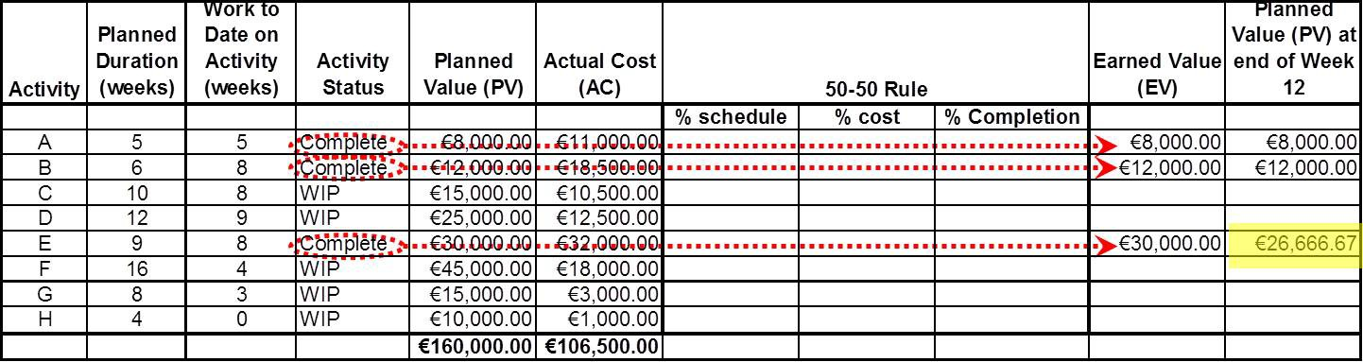
Project Management
Project Cost Management EVMS Worked Example
Step 2 Known Information
Activities A, B and E are complete, therefore the Earned Value (EV) of each activity is equal to its Planned Value (PV).
The Planned Values of A and B at the end of week 12 are also equal to their original Planned Values.
Activity E has finished ahead of schedule and requires different treatment.
104 / 128

Slide 105
Project Management
Project Cost Management EVMS Worked Example
Step 2 Known Information
The Planned value for activity E at end of Week 12:
We are assuming that the planned value will accumulate linearly over the task duration.
Note that this is a simplified method; ideally it will be dependent on the task nature.
8 weeks
_{9 weeks} × €30, 000 = €26, 666.67
105 / 128

Slide 106
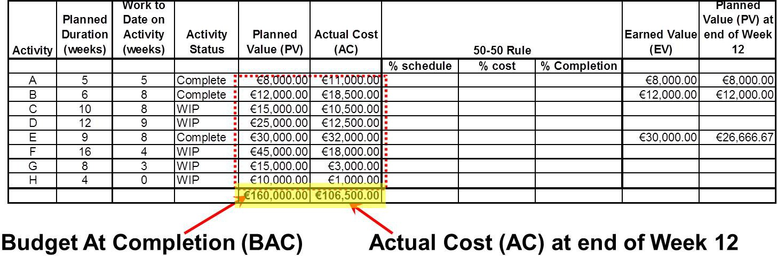
Project Management
Project Cost Management EVMS Worked Example
Step 2 Known Information
Sum the Planned Value (PV) Column: This gives the Planned Value for the entire project
Sum the Actual Cost (AC) Column: This give the total spend to date on the project
106 / 128

Slide 107
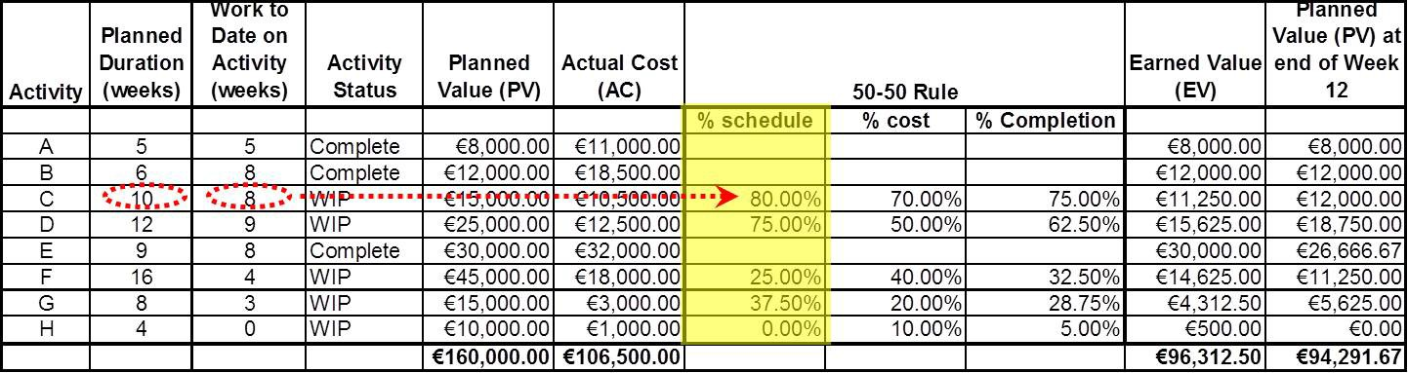
Project Management
Project Cost Management EVMS Worked Example
For the 50-50 Rule, calculate the percentage of schedule by dividing the work to date by the Planned duration,
e.g. Activity C:
8 weeks
_{10 weeks} = 80.00%
107 / 128

Slide 108
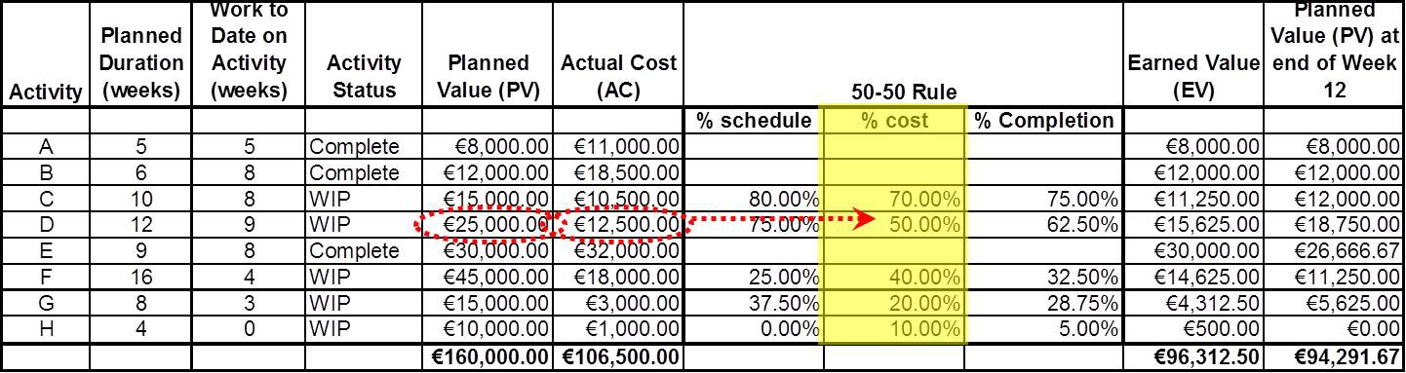
Project Management
Project Cost Management EVMS Worked Example
Now, calculate the percentage of cost by dividing the Actual Cost (AC) of each activity by its Planned Value (PV),
e.g. Activity D:
€12, 500.00
€25, 000.00 ^{= 50.00%}
108 / 128

Slide 109
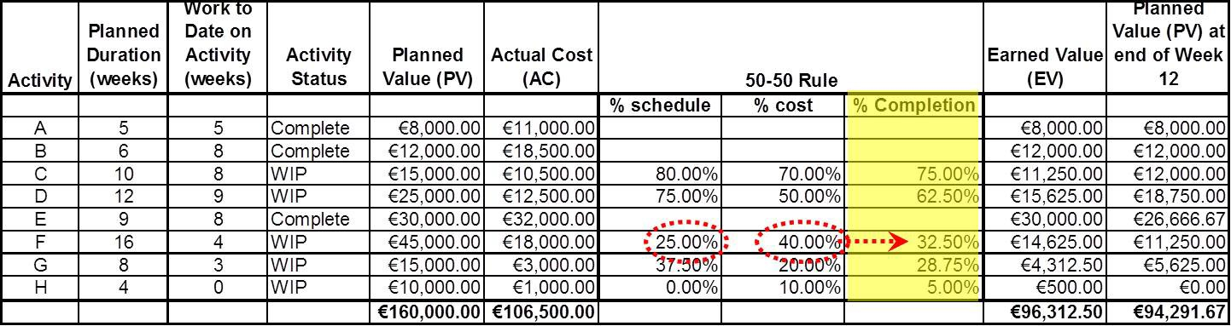
Project Management
Project Cost Management EVMS Worked Example
Next, calculate the actual percentage completion of each activity using the 50-50 rule; add 50% of the percentage schedule completion and 50% of the percentage of cost:
e.g. Activity F:
(25.00% × 0.5) + (40.00% × 0.5) = 32.50%
12.50% + 20.00% = 32.50%
109 / 128

Slide 110
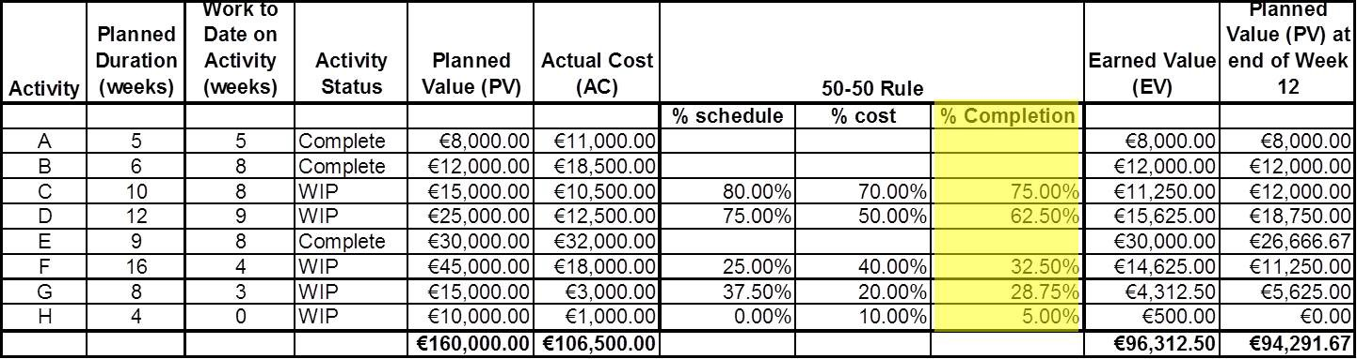
Project Management
Project Cost Management EVMS Worked Example
There is an alternative calculation that is ONLY applicable if the
%age weightings are 0.5 and 0.5. This is to take an average
e.g. Activity F:
25.00% + 40.00%
2
= 32.50%
110 / 128

Slide 111
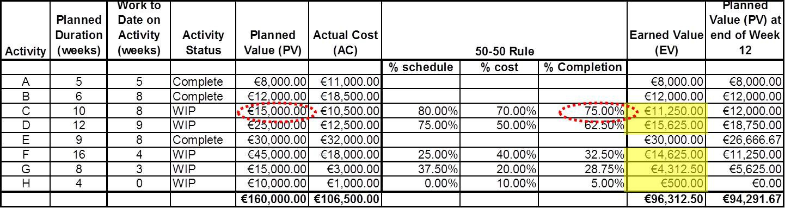
Project Management
Project Cost Management EVMS Worked Example
To calculate the Earned Value (EV) for each activity, multiply the percentage Completion by its Planned Value (PV),
e.g. Activity C:
€15, 000.00 × 75.00% = €11, 250.00
111 / 128

Slide 112
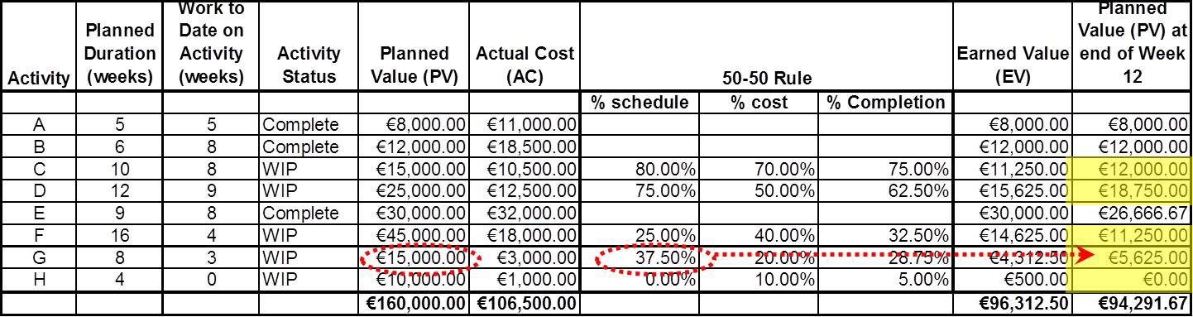
Project Management
Project Cost Management EVMS Worked Example
To calculate the Planned Value at this point in time it is necessary to calculate the Planned Values for each activity,
e.g Activity G:
€15, 000.00 × 37.50% = €5, 625.00
112 / 128

Slide 113
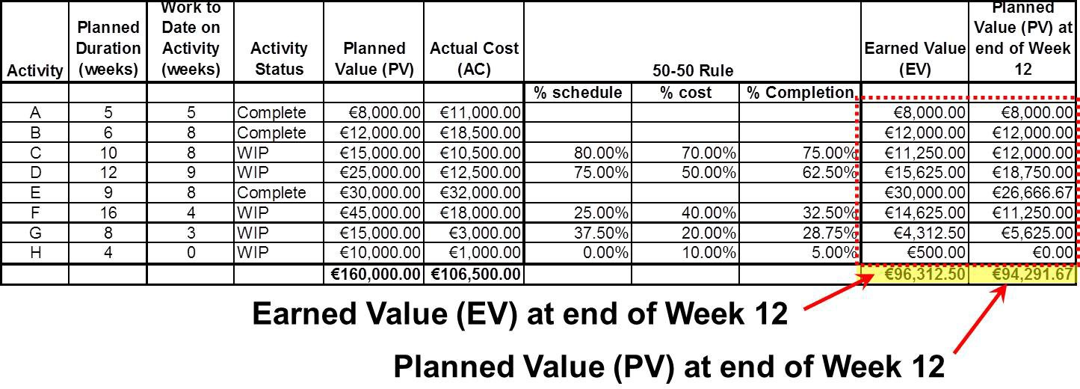
Project Management
Project Cost Management EVMS Worked Example
To calculate the Planned Value and Earned Value at this point in time, Sum the individual Earned Values and Planned Values.
113 / 128

Slide 114
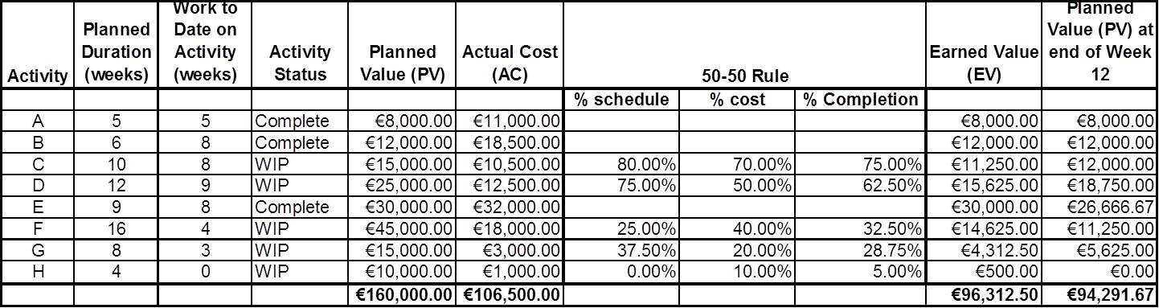
Project Management
Project Cost Management EVMS Worked Example
Summary of information:
Budget at Completion (BAC) | €160,000.00
Actual Cost of Contract to date (AC) | €106,500.00
Earned Value to date (EV) | €96,312.50
Planned Vale to date (PV) | €94,291.67
114 / 128

Slide 115
Project Management
Project Cost Management EVMS Worked Example
Further Calculations
Budget at Completion (BAC) | €160,000.00
Actual Cost of Contract to date (AC) | €106,500.00
Earned Value to date (EV) | €96,312.50
Planned Vale to date (PV) | €94,291.67
Cost Variance (CV) Cost Performance Index (CPI) | −€10,187.50 0.9043
Schedule Variance (SV) | €2,020.83
Schedule Performance Index (SPI) | 1.0214
115 / 128

Slide 116
Project Management
Project Cost Management EVMS Worked Example
Cost Variance (CV)
Budget at Completion (BAC) | €160,000.00
Actual Cost of Contract to date (AC) | €106,500.00
Earned Value to date (EV) | €96,312.50
Planned Vale to date (PV) | €94,291.67
Cost Variance (CV) Cost Performance Index (CPI) | −€10,187.50 0.9043
Schedule Variance (SV) | €2,020.83
Schedule Performance Index (SPI) | 1.0214
Cost Variance equals the Earned Value less Actual Costs to date
CV = EV − AC
CV = €96, 312.50 − €106, 500.00
CV = € − 10,187.50
116 / 128

Slide 117
Project Management
Project Cost Management EVMS Worked Example
Cost Performance Index (CPI)
Budget at Completion (BAC) | e160,000.00
Actual Cost of Contract to date (AC) | e106,500.00
Earned Value to date (EV) | e96,312.50
Planned Vale to date (PV) | e94,291.67
Cost Variance (CV) Cost Performance Index (CPI) | −e10,187.50 0.9043
Schedule Variance (SV) | e2,020.83
Schedule Performance Index (SPI) | 1.0214
Cost Performance Index equals the Earned Value divided by Actual Costs to date
_{CPI =} EV ₌ €96, 312.50
AC €106, 500.00
CPI = 0.9043
117 / 128

Slide 118
Project Management
Project Cost Management EVMS Worked Example
Schedule Variance (SV)
Budget at Completion (BAC) | e160,000.00
Actual Cost of Contract to date (AC) | e106,500.00
Earned Value to date (EV) | e96,312.50
Planned Vale to date (PV) | e94,291.67
Cost Variance (CV) Cost Performance Index (CPI) | −e10,187.50 0.9043
Schedule Variance (SV) | e2,020.83
Schedule Performance Index (SPI) | 1.0214
Schedule Variance equals the Earned Value less Planned Value to date
SV = EV − PV
SV = €96, 312.50 − €94, 291.67
SV = €2, 020.83
118 / 128

Slide 119
Project Management
Project Cost Management EVMS Worked Example
Schedule Performance Index (SPI)
Budget at Completion (BAC) | e160,000.00
Actual Cost of Contract to date (AC) | e106,500.00
Earned Value to date (EV) | e96,312.50
Planned Vale to date (PV) | e94,291.67
Cost Variance (CV) Cost Performance Index (CPI) | −e10,187.50 0.9043
Schedule Variance (SV) | e2,020.83
Schedule Performance Index (SPI) | 1.0214
Schedule Performance Index equals the Earned Value divided by Planned Value to date
_{SPI =} EV ₌ €96, 312.50
PV €94, 291.67
SPI = 1.0214
119 / 128

Slide 120
Project Management
Project Cost Management EVMS Worked Example
Estimate to Completion (ETC) based on Budget
Budget at Completion (BAC) | e160,000.00
Actual Cost of Contract to date (AC) | e106,500.00
Earned Value to date (EV) | e96,312.50
Planned Vale to date (PV) | e94,291.67
Cost Variance (CV) Cost Performance Index (CPI) | −e10,187.50 0.9043
Schedule Variance (SV) | e2,020.83
Schedule Performance Index (SPI) | 1.0214
ETC equals the Budget at Completion less the Earned Value to date
ETC_{BGT} = BAC − EV
ETC_{BGT} = €160, 000 − €96, 312.50
ETC_{BGT} = €63, 687.50
120 / 128

Slide 121
Project Management
Project Cost Management EVMS Worked Example
Estimate to Completion (ETC) based on CPI
Budget at Completion (BAC) | e160,000.00
Actual Cost of Contract to date (AC) | e106,500.00
Earned Value to date (EV) | e96,312.50
Planned Vale to date (PV) | e94,291.67
Cost Variance (CV) Cost Performance Index (CPI) | −e10,187.50 0.9043
Schedule Variance (SV) | e2,020.83
Schedule Performance Index (SPI) | 1.0214
Two Methods of Calculation
_{ETCCPI =} BAC − EV ₌ ETC_{BGT}
CPI CPI
_{ETCCPI =} € 160, 000 − €96, 312.50
0.9043
ETC_{CPI} = €70, 427.40
121 / 128

Slide 122
Project Management
Project Cost Management EVMS Worked Example
Estimate at Completion (EAC) based on Budget
Budget at Completion (BAC) | e160,000.00
Actual Cost of Contract to date (AC) | e106,500.00
Earned Value to date (EV) | e96,312.50
Planned Vale to date (PV) | e94,291.67
Cost Variance (CV) Cost Performance Index (CPI) | −e10,187.50 0.9043
Schedule Variance (SV) | e2,020.83
Schedule Performance Index (SPI) | 1.0214
Two Methods of Calculation
EAC_{BGT} = (BAC − EV ) + AC = ETC_{BGT} + AC EAC_{BGT} = €63, 687.50 + €106, 500.00 EAC_{BGT} = €170, 187.50
122 / 128

Slide 123
Project Management
Project Cost Management EVMS Worked Example
Estimate at Completion (EAC) based on CPI
Budget at Completion (BAC) | e160,000.00
Actual Cost of Contract to date (AC) | e106,500.00
Earned Value to date (EV) | e96,312.50
Planned Vale to date (PV) | e94,291.67
Cost Variance (CV) Cost Performance Index (CPI) | −e10,187.50 0.9043
Schedule Variance (SV) | e2,020.83
Schedule Performance Index (SPI) | 1.0214
Two Methods of Calculation
EAC_{CPI} = ^{BAC − EV} + AC = ETC_{CPI} + AC
CPI
EAC_{CPI} = €70, 427.40 + €106, 500.00
EAC_{CPI} = €176, 927.40
123 / 128

Slide 124
Project Management
Project Cost Management EVMS Worked Example
Percentage Completion
Budget at Completion (BAC) | e160,000.00
Actual Cost of Contract to date (AC) | e106,500.00
Earned Value to date (EV) | e96,312.50
Planned Vale to date (PV) | e94,291.67
Cost Variance (CV) Cost Performance Index (CPI) | −e10,187.50 0.9043
Schedule Variance (SV) | e2,020.83
Schedule Performance Index (SPI) | 1.0214
Earned Value divided by Budget at Completion expressed as a percentage
EV € 96, 312.50
^{%complete =} BAC ⁼ €160, 000.00
%_{complete} = 0.60195 = 60.195%
124 / 128

Slide 125
Project Management
Project Cost Management EVMS Worked Example
Percentage of Budget Spent
Budget at Completion (BAC) | e160,000.00
Actual Cost of Contract to date (AC) | e106,500.00
Earned Value to date (EV) | e96,312.50
Planned Vale to date (PV) | e94,291.67
Cost Variance (CV) Cost Performance Index (CPI) | −e10,187.50 0.9043
Schedule Variance (SV) | e2,020.83
Schedule Performance Index (SPI) | 1.0214
Actual Costs divided by Budget at Completion expressed as a percentage
AC €106, 500.00
^{%budget =} BAC ⁼ €160, 000.00
%_{budget} = 0.66563 = 66.563%
125 / 128

Slide 126
Project Management
Project Cost Management EVMS Worked Example
Project Duration Estimate using the Schedule Performance Index (SPI)
The original project duration was stated as 35 weeks. Therefore,
Estimated Duration = ^{Original Duration}
SPI
35 weeks
1.0214
=
Estimated Duration = 34.27 weeks
126 / 128

Slide 127
Project Management
Project Cost Management EVMS Worked Example
Some Alternatives to the 50-50 Rule
0/100 Rule
Usually limited to small work packages; no value is earned until the task is complete
Milestone
Used for long duration work packages. Value is earned when milestones are completed.
% complete
Used for long duration work packages where milestones cannot be identified. % complete is determined by measurement.
Equivalent Units
Used for similar-unit work packages, where earnings are on completed units rather than labour. e.g kitchen contractor; number of kitchen units installed.
127 / 128

Slide 128
Project Management
Project Cost Management EVMS Worked Example
Comment on EVM
EVM works best when applied to the top 4 levels of the WBS.
Unless the model is linked to the project schedule, the determination of PV can be problematic.
EVM will only highlight issues in relation to cost and schedule.
EVM will not highlight issues on quality, deliverables, scope, etc.
WIP (and thus EV) can be calculated in a number of ways; leaves the system open to manipulation.
EAC and ETC predictions likely to be inaccurate due to unforeseen future for variances. EAC and ETC are indicative only.
In summary, EVM is very useful. However, it must be treated with caution.
128 / 128

